Slide 1

Building Your Best Resume with
Our Website

Slide 2


Introduction
Welcome to our resume building website, where we offer a comprehensive suite of tools and resources to help job seekers craft compelling and effective resumes. Whether you are a recent graduate or a seasoned professional, our platform is designed to simplify the resume writing process and give you the confidence you need to succeed in your job search.

Slide 3


Why Use Our Website?
Easy to Use
Our website is user-friendly
and intuitive, making it easy
for anyone to create a
professional-looking resume
in minutes.
Customizable Templates
Choose from a variety of
customizable templates that
suit your style and needs. Our
templates are designed by professional
resume writers to help you stand
out from the crowd.
Expert Tips and Examples
Our website provides expert tips and
examples to guide you through the resume building process. We help you highlight your strengths and accomplishments to make your resume stand out to potential employers.

Slide 4


Features & Benefits
Customizable Templates
Our website offers a variety of customizable templates that cater to different industries and job positions. You can choose from a range of designs and layouts to create a professional-looking resume that stands out from the crowd.
Easy-to-Use Interface
Our website's user-friendly interface makes it easy for anyone to create a resume. You don't need any prior experience with resume building software to use our platform. Simply follow the step-by-step instructions and fill in your details to generate a professional-quality resume in minutes.
Automatic Formatting
Our website automatically formats your resume to ensure that it meets industry standards. You don't have to worry about spacing, margins, or font sizes. Our platform takes care of all of that for you, so you can focus on creating a compelling resume that highlights your skills and experiences.

Slide 5
Keyword Optimization
Our website uses advanced algorithms to optimize your resume for the keywords that recruiters and hiring managers are looking for. This increases your chances of getting noticed and shortlisted for an interview.
Multiple File Formats
Our website allows you to download your resume in multiple file formats, including PDF, Word, and HTML. This gives you the flexibility to choose the format that works best for you and your job application.
Expert Tips & Examples
Our website provides expert tips and examples to help you create a resume that showcases your skills and experiences. We offer guidance on everything from formatting to content, so you can be confident that your resume is the best it can be.
Free Pricing Plans
Our website offers affordable pricing plans that cater to different budget and needs. Whether you're a recent graduate or an experienced professional, we have a plan that works for you.
24/7 Customer Support
Our website provides 24/7 customer support to help you with any questions or issues you may have. Whether you need help with formatting or customization, our support team is always available to assist you.

Slide 6


Resume Building Process
Step 1: Choose a Template
Select from our library of professionally designed templates to find the perfect layout for your resume.
Step 2: Add Your Information
Fill in your personal and professional information, including your work history, education, skills, and achievements.
Step 3: Customize Your Resume
Tailor your resume to your specific needs by customizing the font, colors, and layout of your template.
Step 4: Review and Edit
Review your completed resume and make any necessary edits or changes before finalizing it for submission.

Slide 7
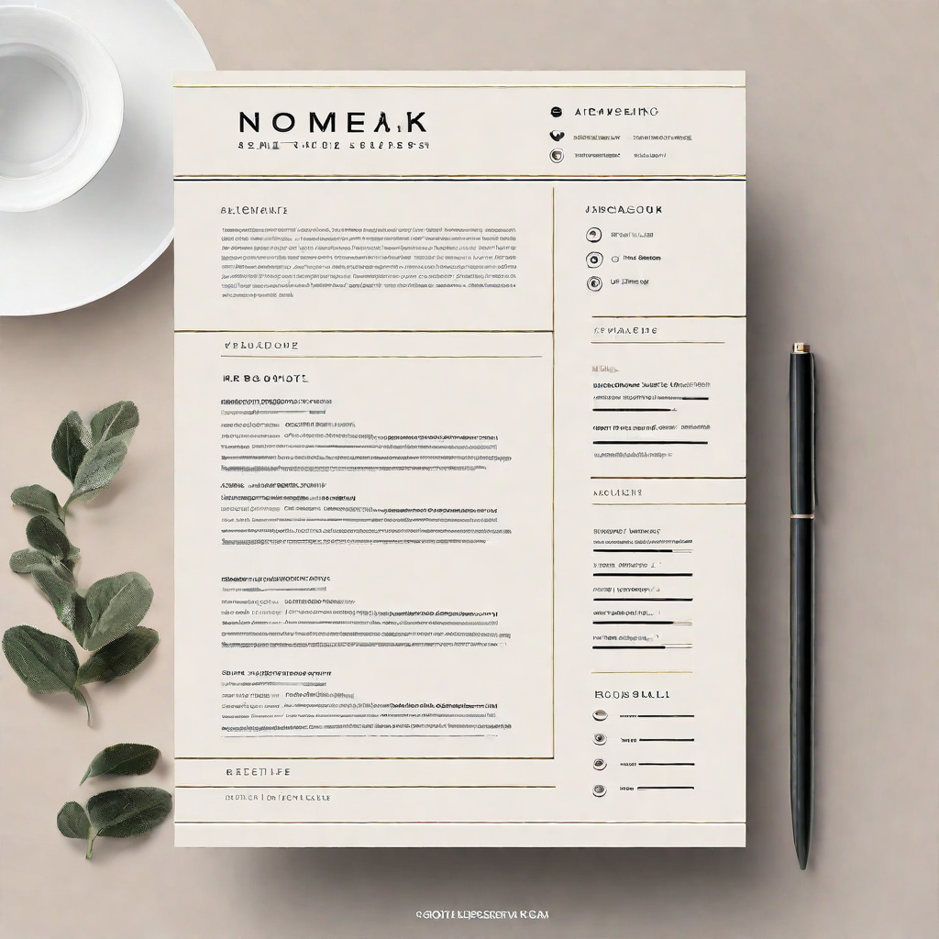
Customization Options
Our resume building website offers a wide range of customization options to ensure that your resume stands out from the rest. With our easy-to-use interface, you can customize every aspect of your resume, including:
Choice of multiple templates to suit your profession and style preferences.
Customizable sections to highlight your skills, experience, education, and achievements.
Option to add a professional profile picture to your resume.
Ability to add custom sections and fields to your resume.

Slide 8
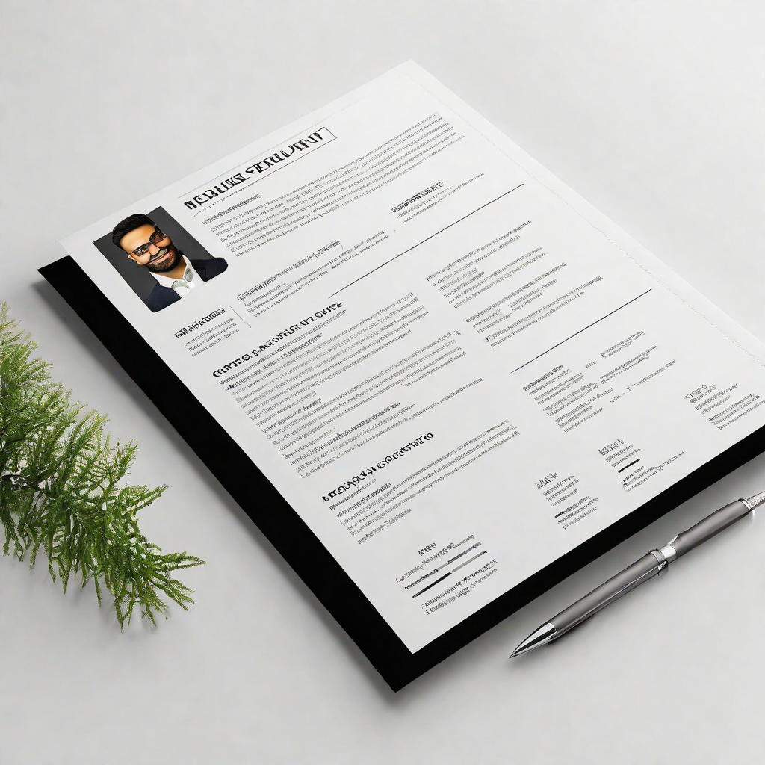
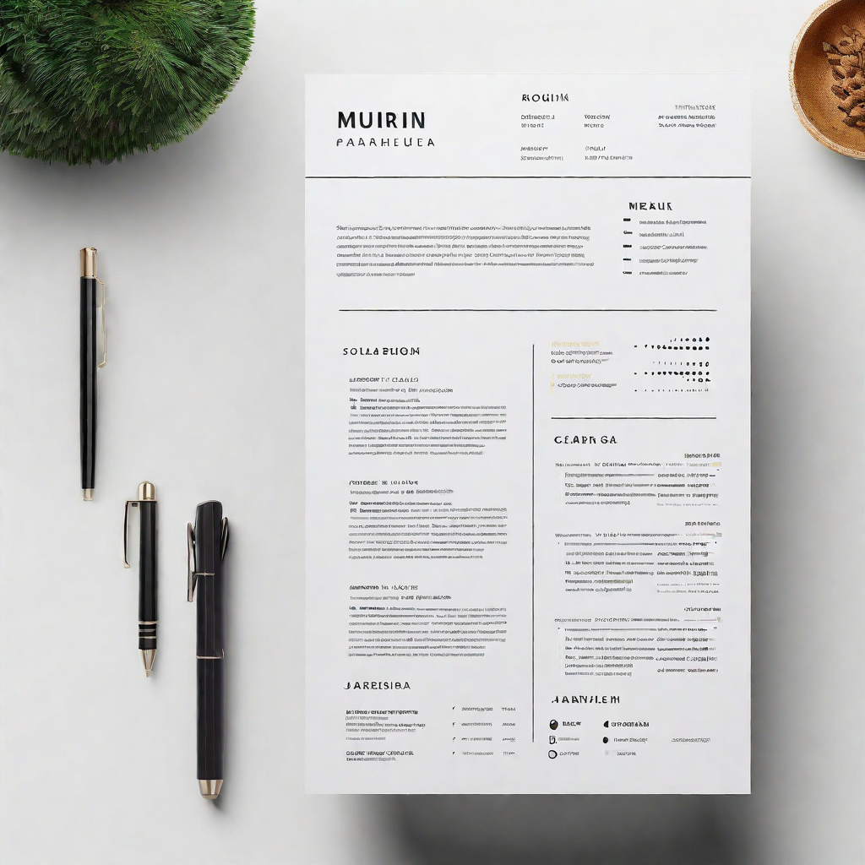
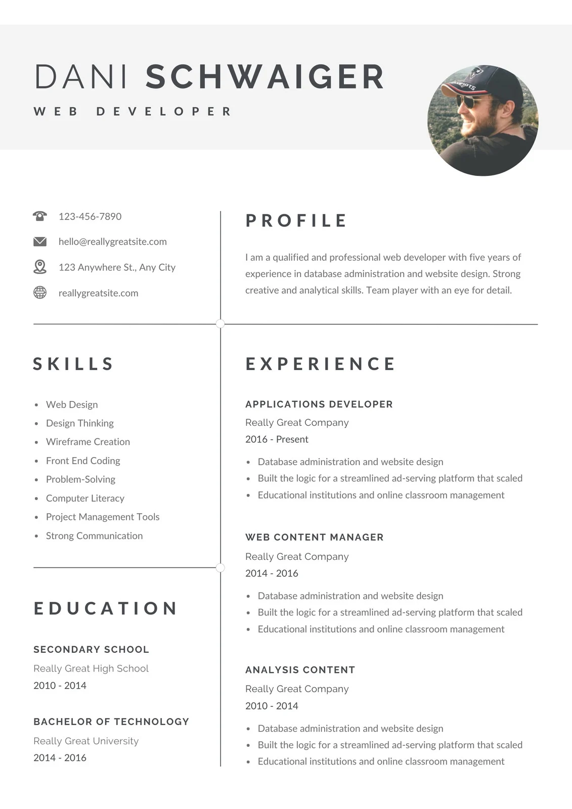
Resume Examples & Tips
Resume Writing Tips
1. Keep it concise and to the point. Limit your resume to one or two pages maximum.
2. Use bullet points to make your achievements and responsibilities stand out.
3. Tailor your resume to the job you're applying for by highlighting relevant skills and experiences.
4. Use action verbs to describe your accomplishments and responsibilities.
5. Proofread your resume carefully for spelling and grammar errors.
Resume Examples
Our website offers a variety of resume examples to help you get started, including professional, creative, and entry-level resumes.
Each example includes tips and suggestions for formatting, wording, and content to help you create a standout resume.

Slide 9


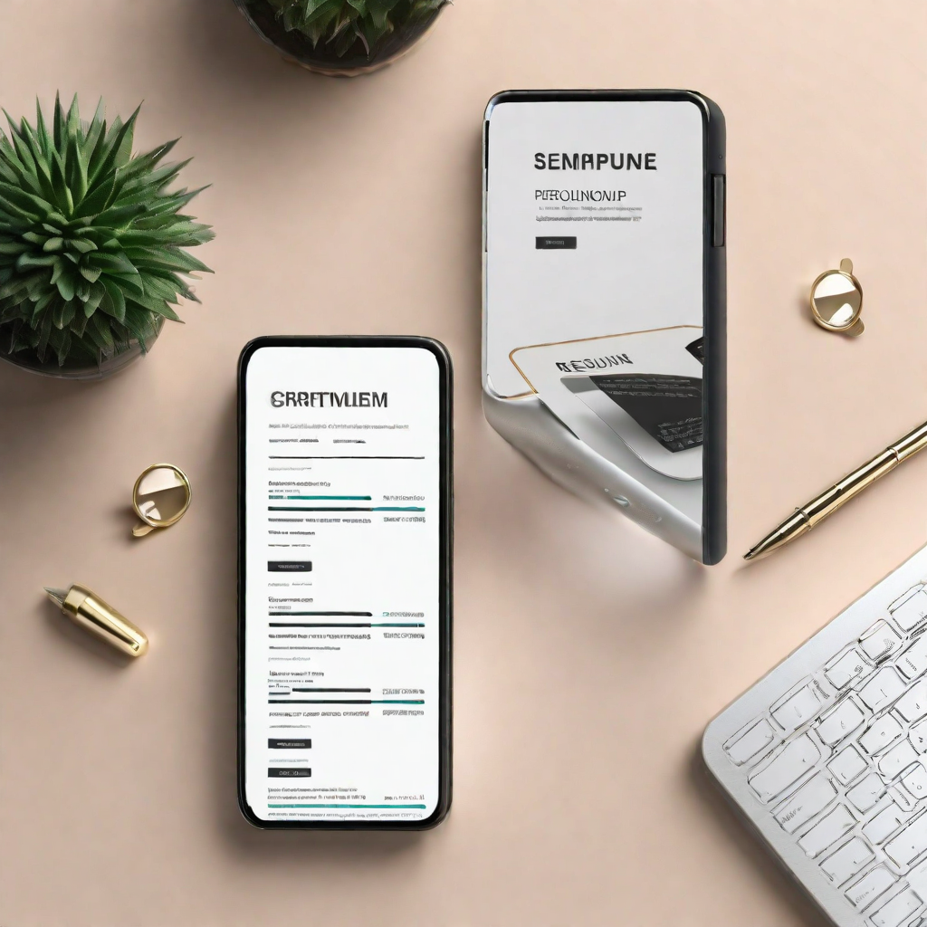
Pricing Plans
Free Plan
Our free plan allows you to create and download a basic resume with limited customization options.

Slide 10
Customer Support
We pride ourselves on providing excellent customer support to our users. Our team of experts is available 24/7 to answer any questions or concerns you may have.
Whether you need help navigating our website, customizing your resume, or choosing the right pricing plan, our customer support team is here to assist you every step of the way.
24/7 availability
Expert guidance and advice
Prompt and efficient resolution of issues

Slide 11

Conclusion
Our resume building website offers a range of features and benefits that make it a top choice for job seekers. With our user-friendly interface, customizable templates, and expert tips and advice, we make it easy to create a professional resume that stands out from the crowd. And with our flexible pricing plans and dedicated customer support team, we're committed to providing the best possible experience for our users. Whether you're just starting your job search or looking to take your career to the next level, our website has everything you need to succeed.

